Slide 1
SKYFI
PRECIOS Y ALCANCES

Slide 2
01
PRODUCTOS
02
INDUSTRIAS
03
PARTNERS
04
PRECIOS COMERCIALES
CONTENIDO
05
A TENER EN CUENTA
06
SOBRE LA API
07
OBTENER APIKEY
08
PROCESO Y ALCANCES

Slide 3
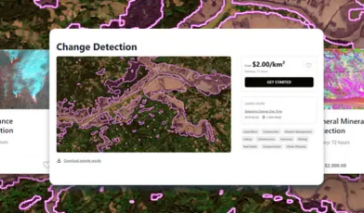
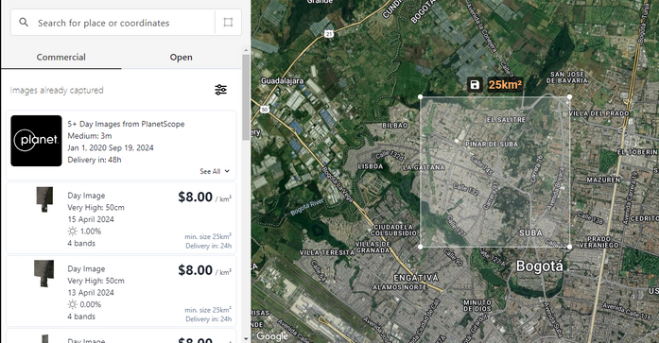
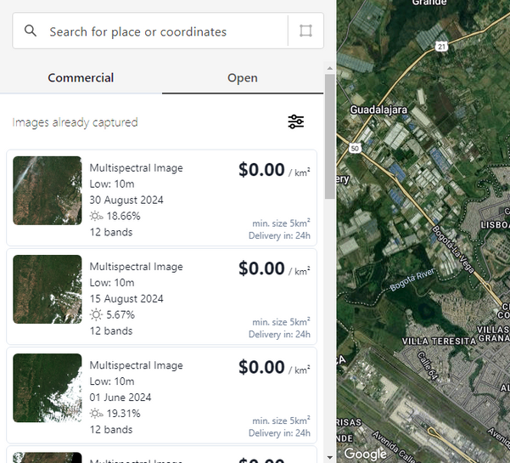
PRODUCTOS
Imágenes
comerciales
Analítica
Open Data
A partir de $5
A partir de $25
Disponible GRATIS

Slide 4
INDUSTRIAS
ENVIRONMENT
Skyfi ofrece imágenes satelitales y herramientas analíticas que permiten a las empresas
obtener una ventaja competitiva,
comprender los riesgos antes de iniciar un proyecto o
monitorear los cambios de los últimos 5 años.
INSURANCE
MINING
AGRICULTURE
ENERGY
GOVERNMENT
CONSTRUCTION & REAL STATE

Slide 5

PARTNERS

Slide 6
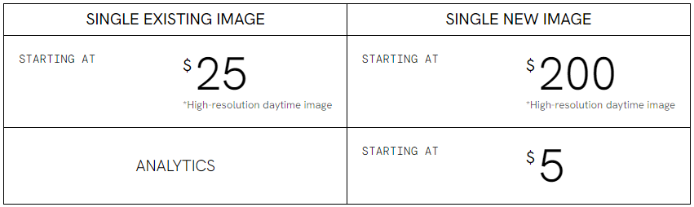
PRECIOS COMERCIALES
DAYTIME (OPTICAL) IMAGES
SAR IMAGES
https://skyfi.com/en/pricing
STEREO IMAGES

Slide 7
PRECIOS COMERCIALES
Precio por km2
Low Resolution - Open Data
Resoluciones
Priority Surcharge por km2
Ultra High Resolution
Super High Resolution
Very High Resolution
High Resolution
Medium Resolution
Tiempos de entrega
Existing Image - Hasta 24hrs
New Image - Hasta 48hrs
Analytic - Depende el servicio

Slide 8
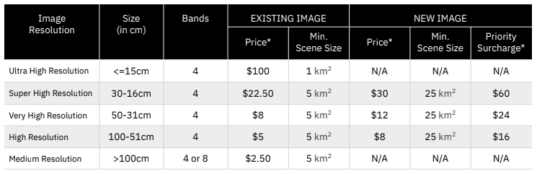
DAYTIME (OPTICAL) IMAGES
This straightforward snapshot resembles a typical image, capturing Earth in a way that feels familiar and accessible to everyone. This product also incorporates a fourth, near-infrared band for comprehensive coverage at an affordable cost.

Slide 9
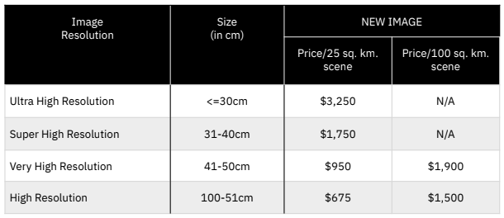
SAR IMAGES
Unveil the unseen with our SAR technology. While it arrives in black and white, don't be fooled – it's a detail powerhouse. This monochrome marvel slices through clouds and haze, revealing a wealth of information that might be obscured in traditional imagery.

Slide 10
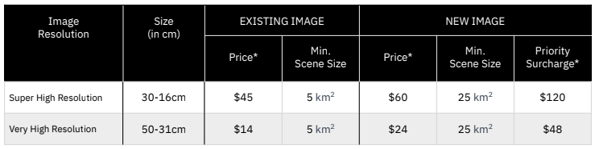
STEREO IMAGES
Heighten your understanding of the terrain with Stereo imagery.
Derived from the same satellites as our Optical day product, these dual images enable you to extract elevations and heights, utilizing the parallax effect to enhance your insights into Earth's topography.

Slide 11
A TENER EN CUENTA
Commercial
PRODUCT TYPE | RESOLUTIONS | SIZE in (cm) | EO | BANDS
DAY | Ultra High | <= 15 | 7cm | 4
 | Super High | 16-30 | 30cm
 | Very High | 31-50 | 50cm
 | High | 51-100 | 75cm - 99cm
 | Medium | >100 | 3 m (Only Planet) | 8
SAR | Ultra High | <= 30 | 7cm | 1
 | Super High | 31-40 | 30cm
 | Very High | 41-50 | 50cm
 | High | 51-100 | 75cm - 99cm
STEREO | Super High | 16-30
 | Very High | 31-50

Slide 12
SOBRE LA API
Entrega al depósito S3 de AWS
API KEY
Access Key
Secret Key
Open Data
Product Type
DAY
MULTISPECTRAL
Resolution
LOW
Reenvío de pedido
Calcular el tamaño del AOI en km2
500 vértices y hasta 500,000 km²
Generar un AOI con un punto central

Slide 13
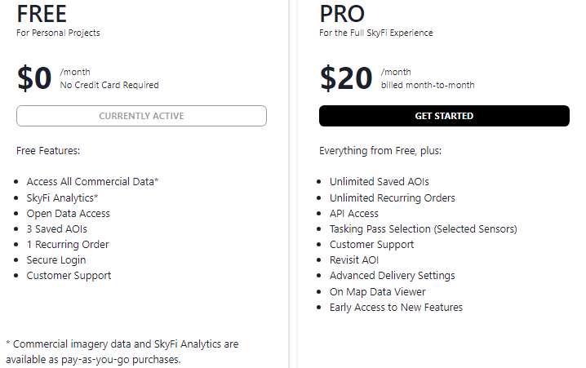
OBTENER APIKEY COMMERCIAL
For Individuals Monthly

Slide 14
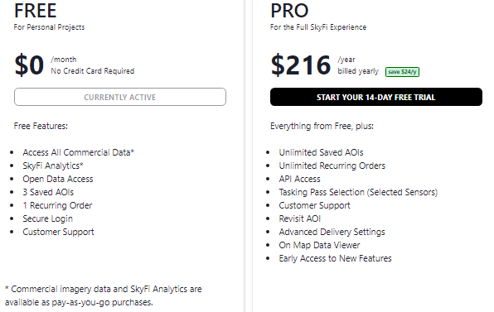
OBTENER APIKEY COMMERCIAL
For Individuals Yearly

Slide 15
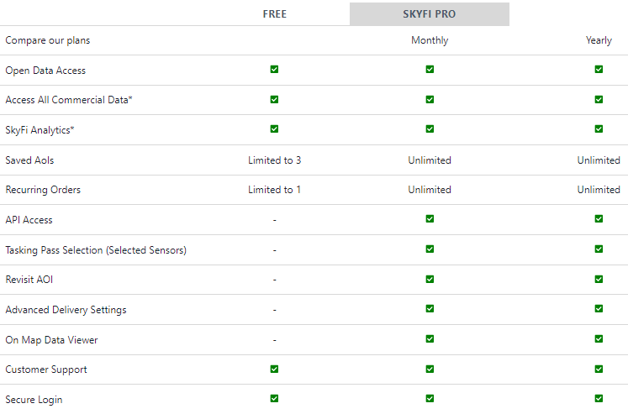
SEE ALL FEATURES
For Individuals
https://app.skyfi.com/pricing

Slide 16
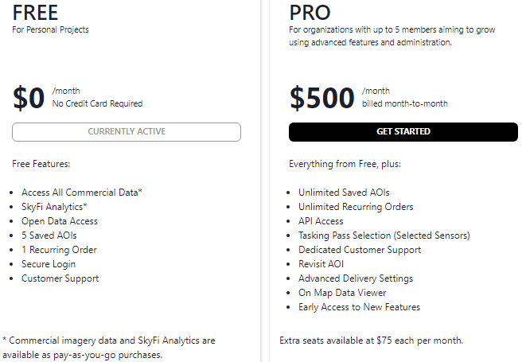
OBTENER APIKEY COMMERCIAL
For Organizations Monthly

Slide 17
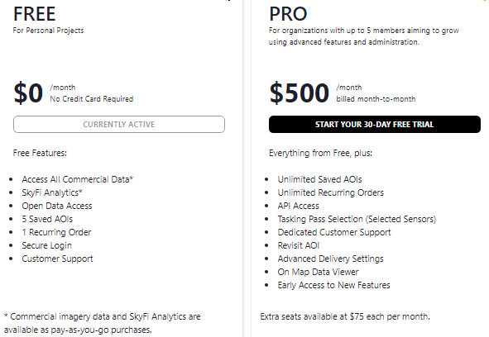
OBTENER APIKEY COMMERCIAL
For Organizations Yearly

Slide 18
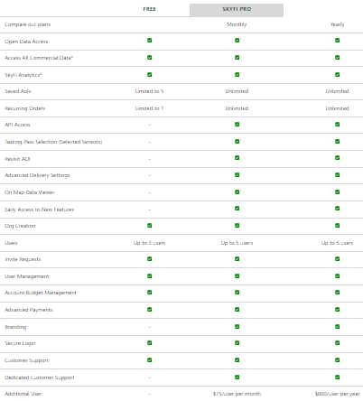
SEE ALL FEATURES
For Organizations
https://app.skyfi.com/pricing

Slide 19
PROCESO Y ALCANCES
Acceder a Open Data
Obtener ApiKey
Acceder a Commercial Data
Comunicarse directamente con api@skyfi.com

Slide 20
Javier Andrés Luis González
jluis@procalculo.com
Muchas Gracias!

Slide 21
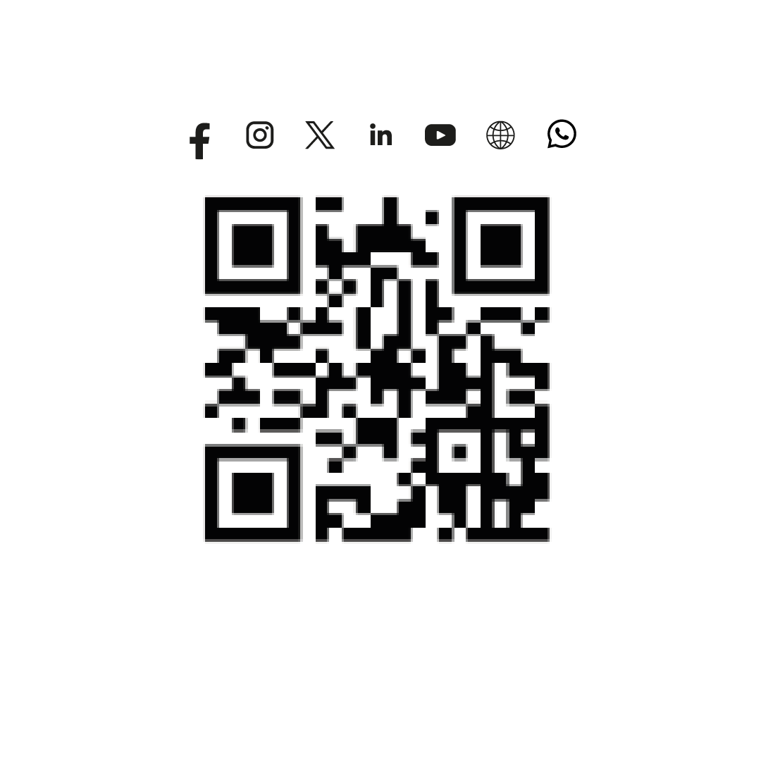
Muchas Gracias!

